Slide 1
FINAL PROJECT SUBMISSION NAME : Ishan Rajendra Burchunde COLLEGE NAME : Sinhgad College Of Engineering

Slide 2
PROJECT NAME : ARDUINO BASED LINE FOLLOWER ROBO

Slide 3
REQUIRE MATERIAL :
1x ARDUINO UNO
2x IR SENSOR
2WD CAR KIT
L298N MOTER DRIVER
BATTERY 9V-12V (DC POWER SUPPLY 10 V)
JUMPER WIRE
DOUBLE SIDE TAPE
BLACK ELECTRICAL TAPE
2x TT MOTOR
SWITCH

Slide 4
PROJECT - RELATED DESCRIPTION :
My internship project centered around the design and development of an Arduino-based Line Follower Robot, a cutting-edge application of robotics and automation. The primary focus was to create a robot capable of autonomously tracking and following a black line on a given surface. This project not only enhanced my technical skills but also provided hands-on experience in addressing real-world challenges in robotics.

Slide 5
Key Features and Components:
Hardware Integration: Assembled a robust robotic platform using motors, wheels, and a chassis, ensuring stability and durability for effective navigation.
Infrared Sensor Array: Integrated infrared sensors strategically on the robot to detect the contrast between the black line and the surrounding surface, providing crucial input for decision-making.
Arduino Microcontroller: Programmed the Arduino microcontroller to act as the brain of the robot, processing sensor data and controlling motor movements for precise line following.

Slide 6
Functionality and Operation:
The robot operates by constantly scanning the surface beneath it using the infrared sensors. When the sensors detect the black line, the Arduino executes algorithms to adjust the motor speeds and direction, ensuring that the robot stays on course. This dynamic decision-making process allows the robot to navigate complex paths with ease.

Slide 7
Algorithmic Challenges:
One of the primary challenges was optimizing the algorithms to handle sharp turns, intersections, and variations in line thickness. Through iterative testing and refinement, the robot's algorithms were fine-tuned to deliver consistent and accurate line following performance.

Slide 8
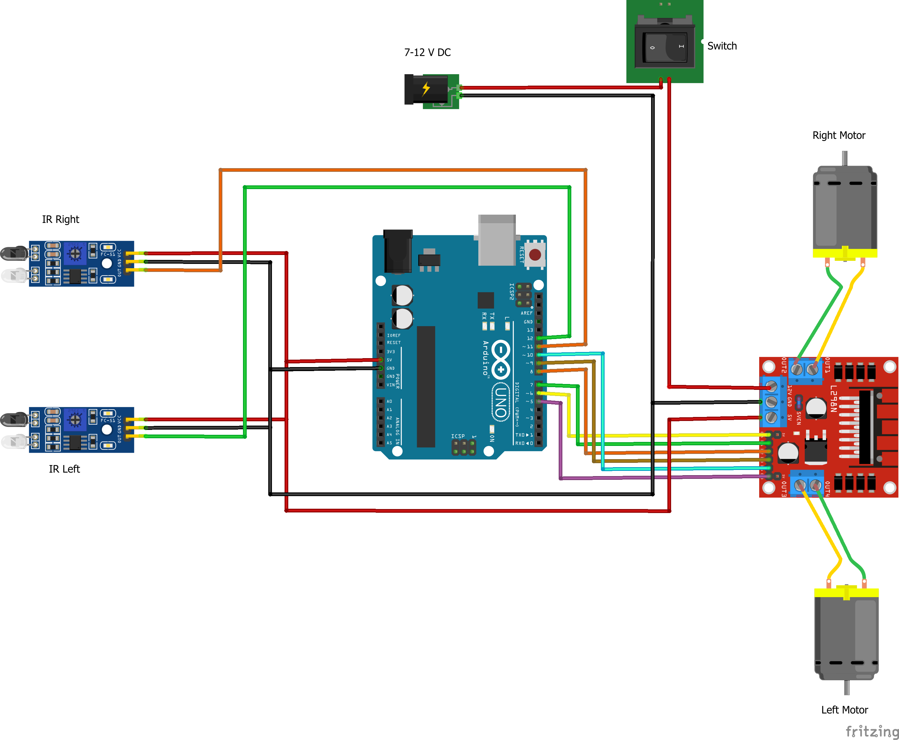
CIRCUIT DIAGRAM :

Slide 9
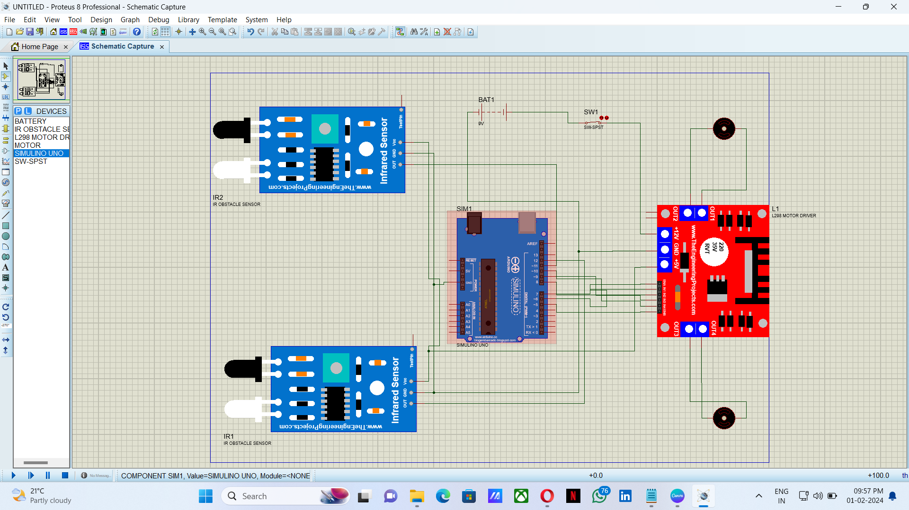
SOFTWARE :

Slide 10
ARDUINO SOFTWARE CODE :
#define IR_SENSOR_RIGHT 11
#define IR_SENSOR_LEFT 12
#define MOTOR_SPEED 180
//Right motor
int enableRightMotor=6;
int rightMotorPin1=7;
int rightMotorPin2=8;
//Left motor
int enableLeftMotor=5;
int leftMotorPin1=9;
int leftMotorPin2=10;
void setup()
{
//The problem with TT gear motors is that, at very low pwm value it does not even rotate.
//If we increase the PWM value then it rotates faster and our robot is not controlled in that speed and goes out of line.
//For that we need to increase the frequency of analogWrite.
//Below line is important to change the frequency of PWM signal on pin D5 and D6
//Because of this, motor runs in controlled manner (lower speed) at high PWM value.
//This sets frequecny as 7812.5 hz.
TCCR0B = TCCR0B & B11111000 | B00000010 ;
// put your setup code here, to run once:
pinMode(enableRightMotor, OUTPUT);
pinMode(rightMotorPin1, OUTPUT);
pinMode(rightMotorPin2, OUTPUT);
pinMode(enableLeftMotor, OUTPUT);
pinMode(leftMotorPin1, OUTPUT);
pinMode(leftMotorPin2, OUTPUT);
pinMode(IR_SENSOR_RIGHT, INPUT);
pinMode(IR_SENSOR_LEFT, INPUT);
rotateMotor(0,0);
}
void loop()
{
int rightIRSensorValue = digitalRead(IR_SENSOR_RIGHT);
int leftIRSensorValue = digitalRead(IR_SENSOR_LEFT);
//If none of the sensors detects black line, then go straight
if (rightIRSensorValue == LOW && leftIRSensorValue == LOW)
{
rotateMotor(MOTOR_SPEED, MOTOR_SPEED);
}
//If right sensor detects black line, then turn right
else if (rightIRSensorValue == HIGH && leftIRSensorValue == LOW )
{
rotateMotor(-MOTOR_SPEED, MOTOR_SPEED);
}
//If left sensor detects black line, then turn left
else if (rightIRSensorValue == LOW && leftIRSensorValue == HIGH )
{
rotateMotor(MOTOR_SPEED, -MOTOR_SPEED);
}
//If both the sensors detect black line, then stop
else
{
rotateMotor(0, 0);
}
}
void rotateMotor(int rightMotorSpeed, int leftMotorSpeed)
{
if (rightMotorSpeed < 0)
{
digitalWrite(rightMotorPin1,LOW);
digitalWrite(rightMotorPin2,HIGH);
}
else if (rightMotorSpeed > 0)
{
digitalWrite(rightMotorPin1,HIGH);
digitalWrite(rightMotorPin2,LOW);
}
else
{
digitalWrite(rightMotorPin1,LOW);
digitalWrite(rightMotorPin2,LOW);
}
if (leftMotorSpeed < 0)
{
digitalWrite(leftMotorPin1,LOW);
digitalWrite(leftMotorPin2,HIGH);
}
else if (leftMotorSpeed > 0)
{
digitalWrite(leftMotorPin1,HIGH);
digitalWrite(leftMotorPin2,LOW);
}
else
{
digitalWrite(leftMotorPin1,LOW);
digitalWrite(leftMotorPin2,LOW);
}
analogWrite(enableRightMotor, abs(rightMotorSpeed));
analogWrite(enableLeftMotor, abs(leftMotorSpeed));
}

Slide 11
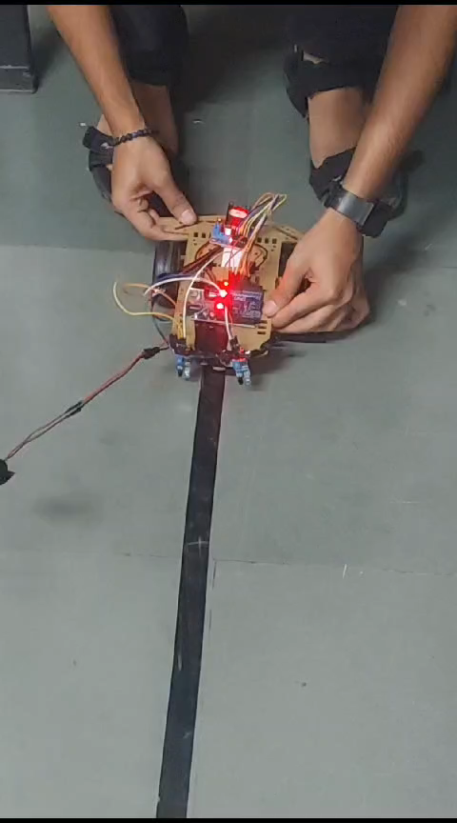
VIDEO / SIMULATION:

